Slide 1

Royal University of Phnom Penh
Web Application Development
Website Topic
Blog Website
Team member:
Heang Seakhong
Chin Chetra
Sren Channak
Heang Sophearous
Aoun Phanna
Lecture by Chim Buthoeurn
https://github.com/seakhong137/WebsiteAssignmentS2

Slide 2
Content
Why we choose to make this website?
Programing Language Used
Front End
Back End

Slide 3
Why we choose to make this website?
Popularity
Sharing knowledge

Slide 4
Programing Language Used
PHP (PHP Framework Laravel 6)
HTML
CSS
JAVASCRIPT
JQUERY

Slide 5
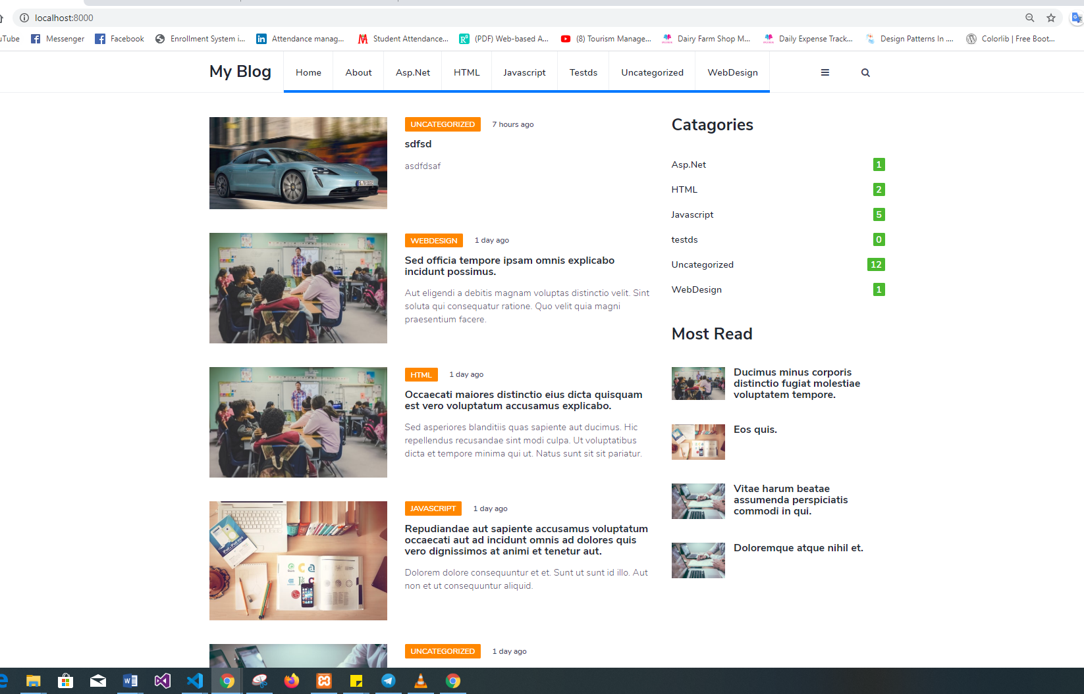
Front End

Slide 6
Front End
Responsive
Search
Can View Post by Category
Leave Comment

Slide 7
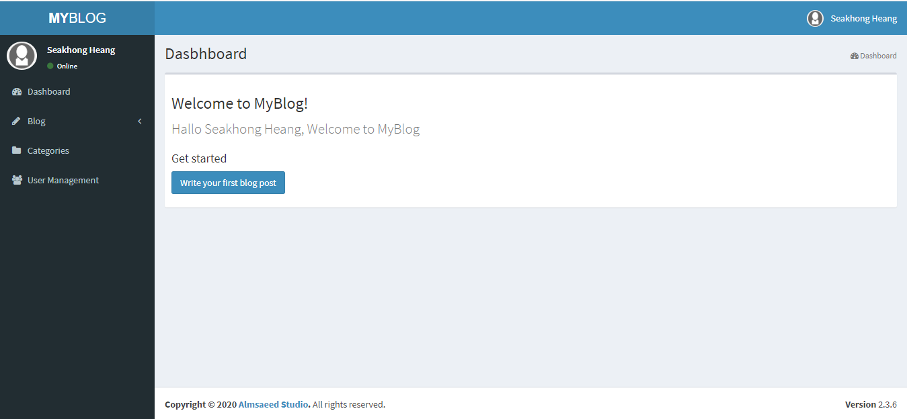
Back End

Slide 8
Back End
Manage Post, Category and User
User Role (Admin, Editor, Author)

Slide 9
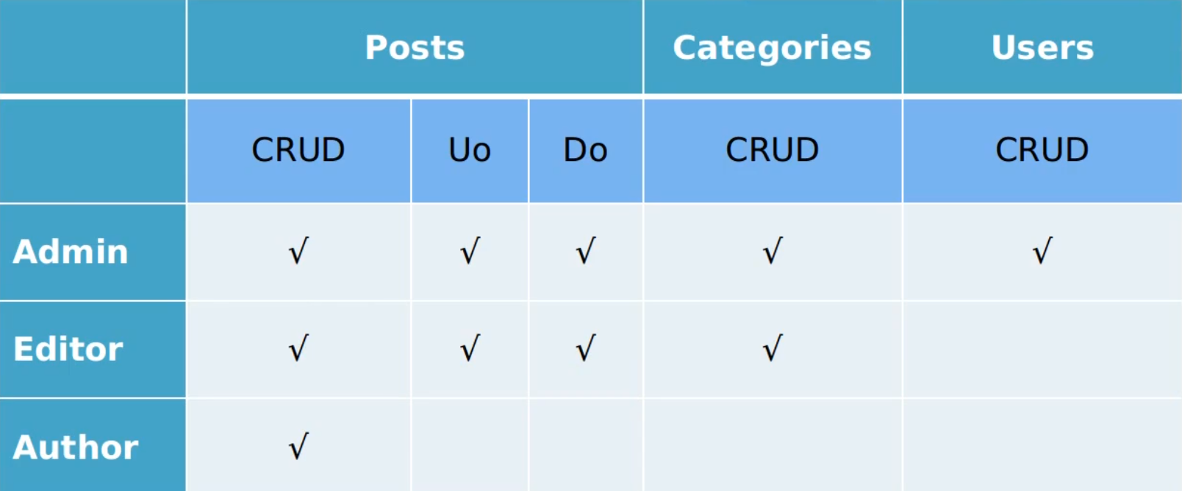
Back End
User Role

Slide 10
Incapability
Can upload only one photo
Can not reply any comment
Can not manage comment for CMS

Slide 11
Demo

